Slide 1
Linux &Apache Project Ecommerce Website
Mandeep Shergill
12th April,2024

Slide 2
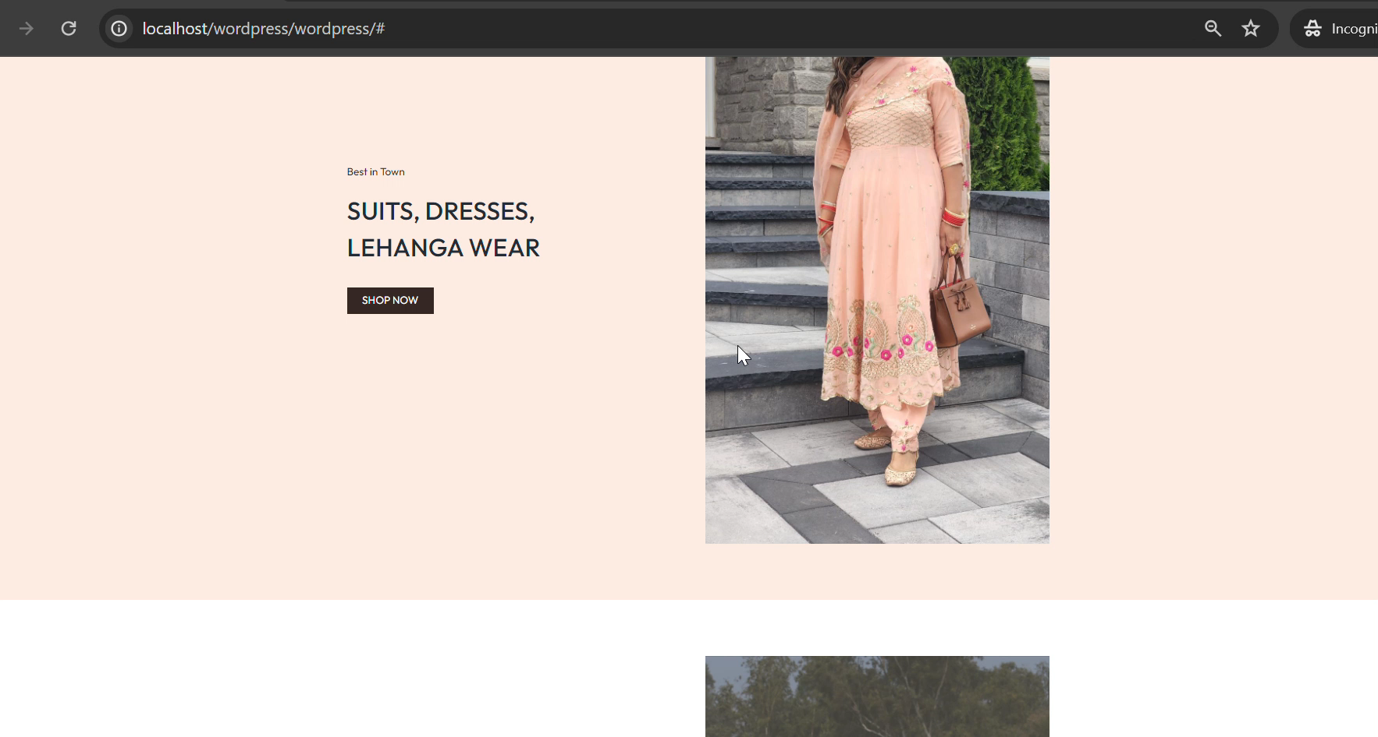
Home Page- Video of whole Page Header page

Slide 3
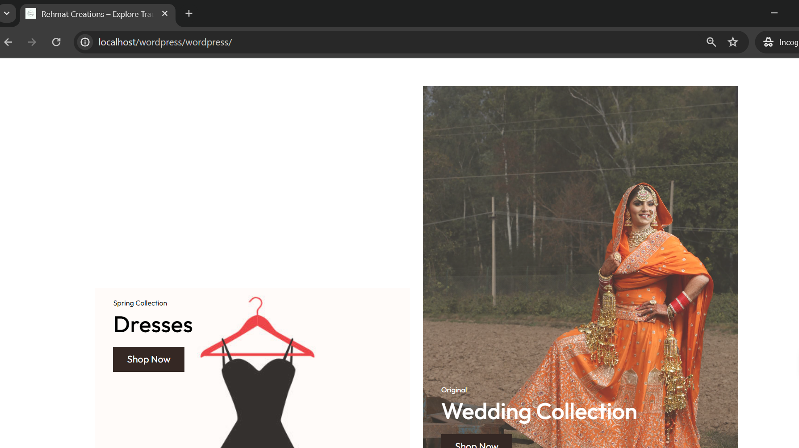
Home Page – 2nd part

Slide 4
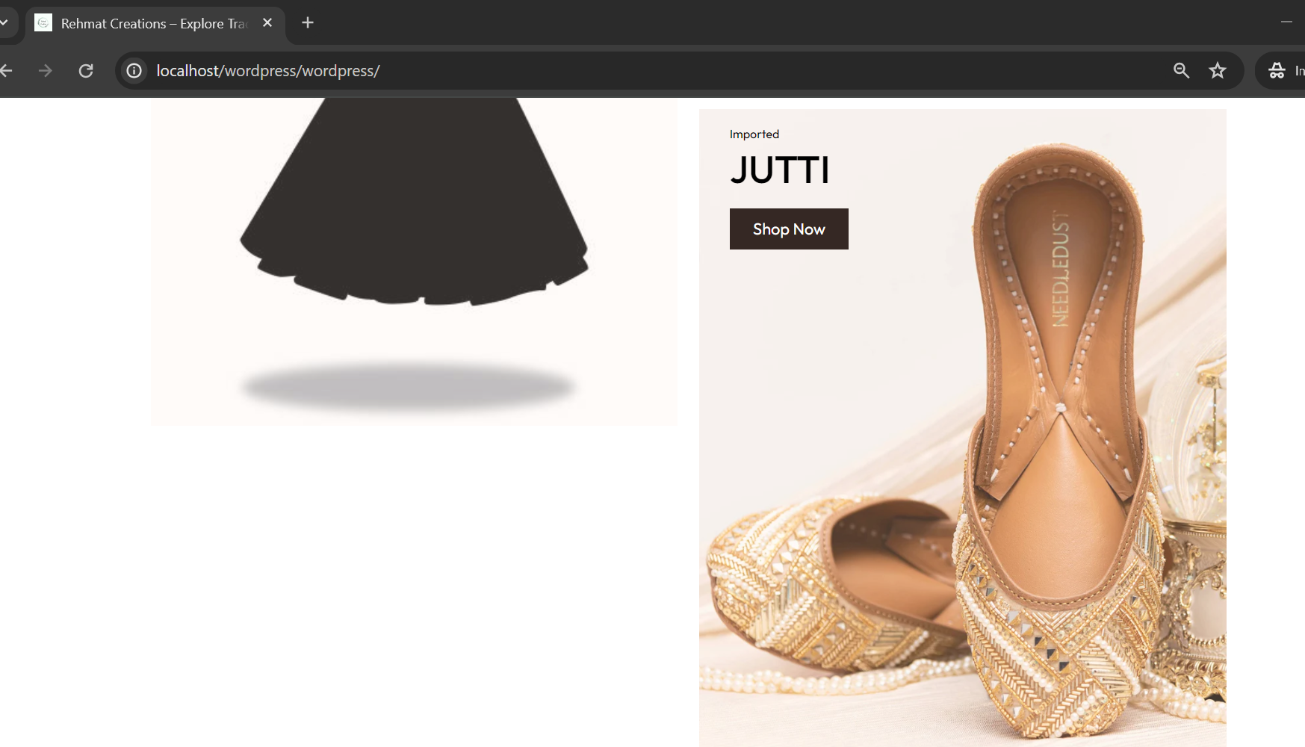
Home page 3rd part

Slide 5
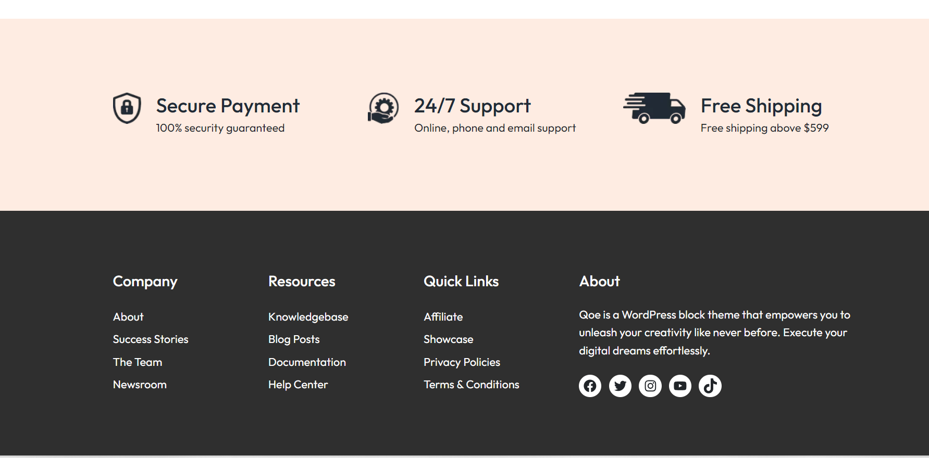
Footer of Homepage

Slide 6
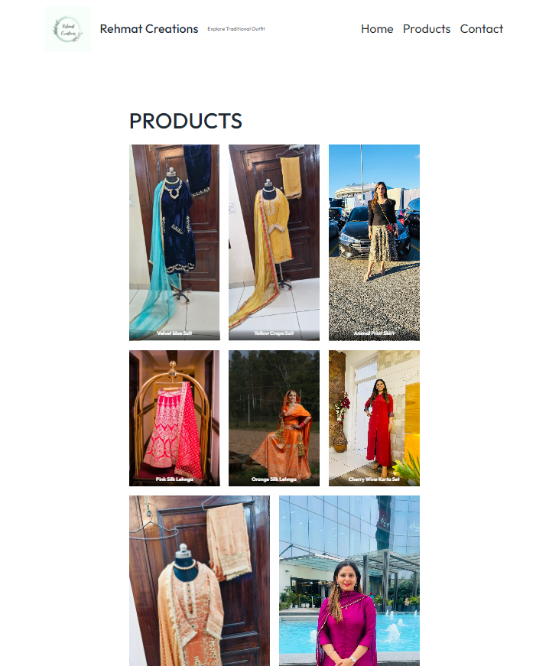
Product Page

Slide 7
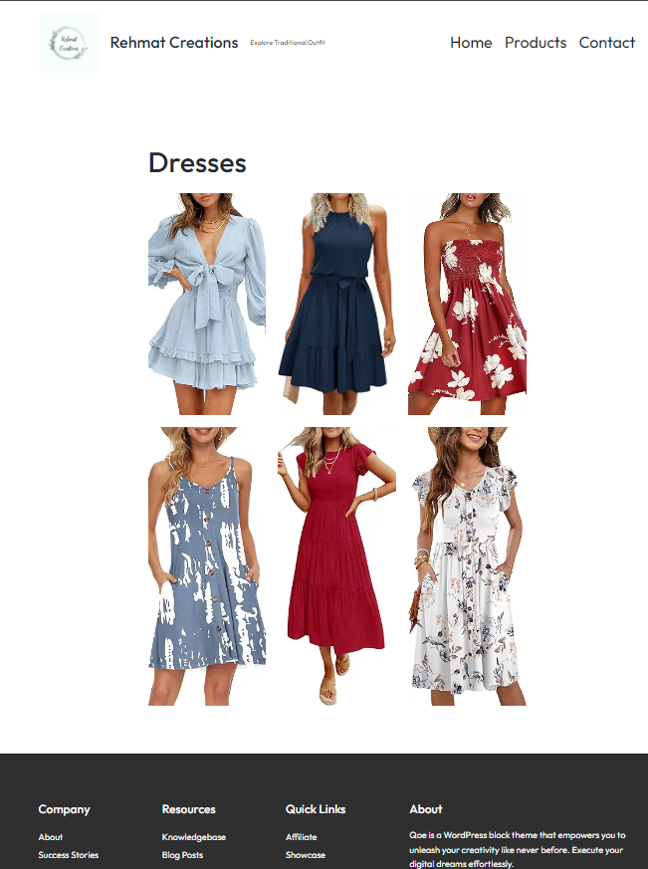
Dresses Page – Linked with Home Page

Slide 8

Wedding Collection – Linked with Home Page

Slide 9

Footwear page linked with home page

Slide 10
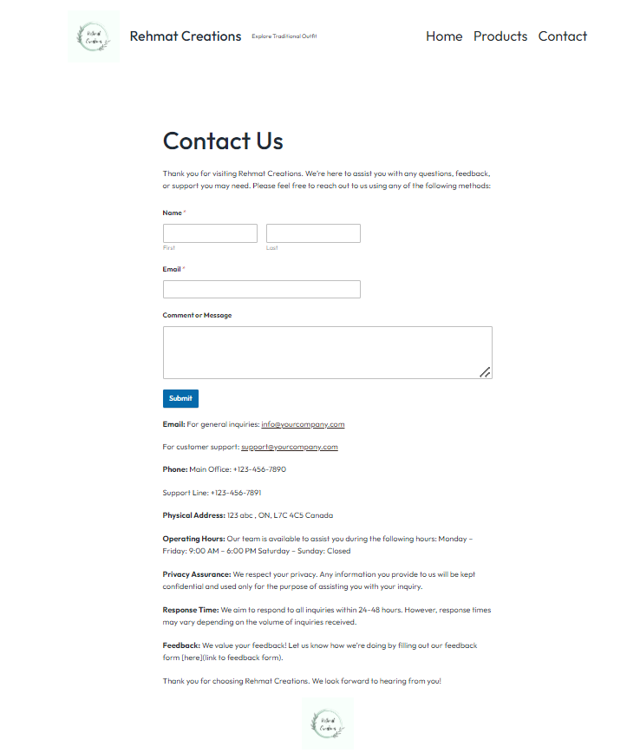
Contact Page with Pluggins

Slide 11
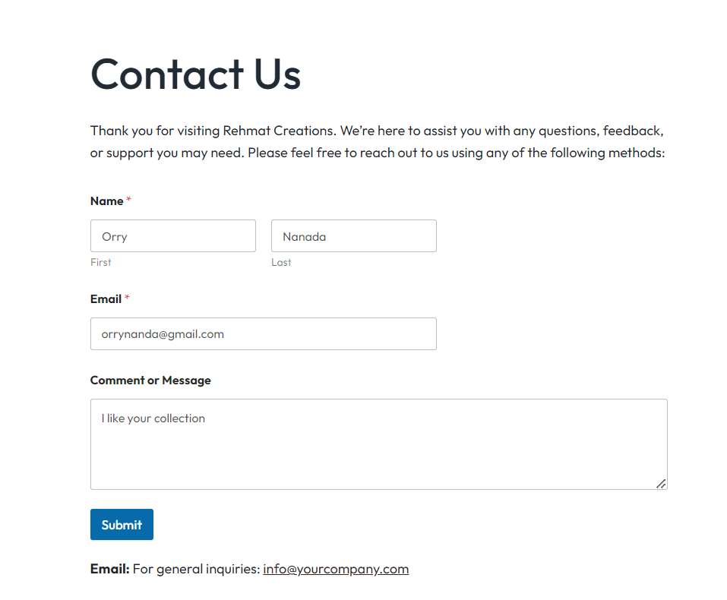
Filled Contact Page

Slide 12
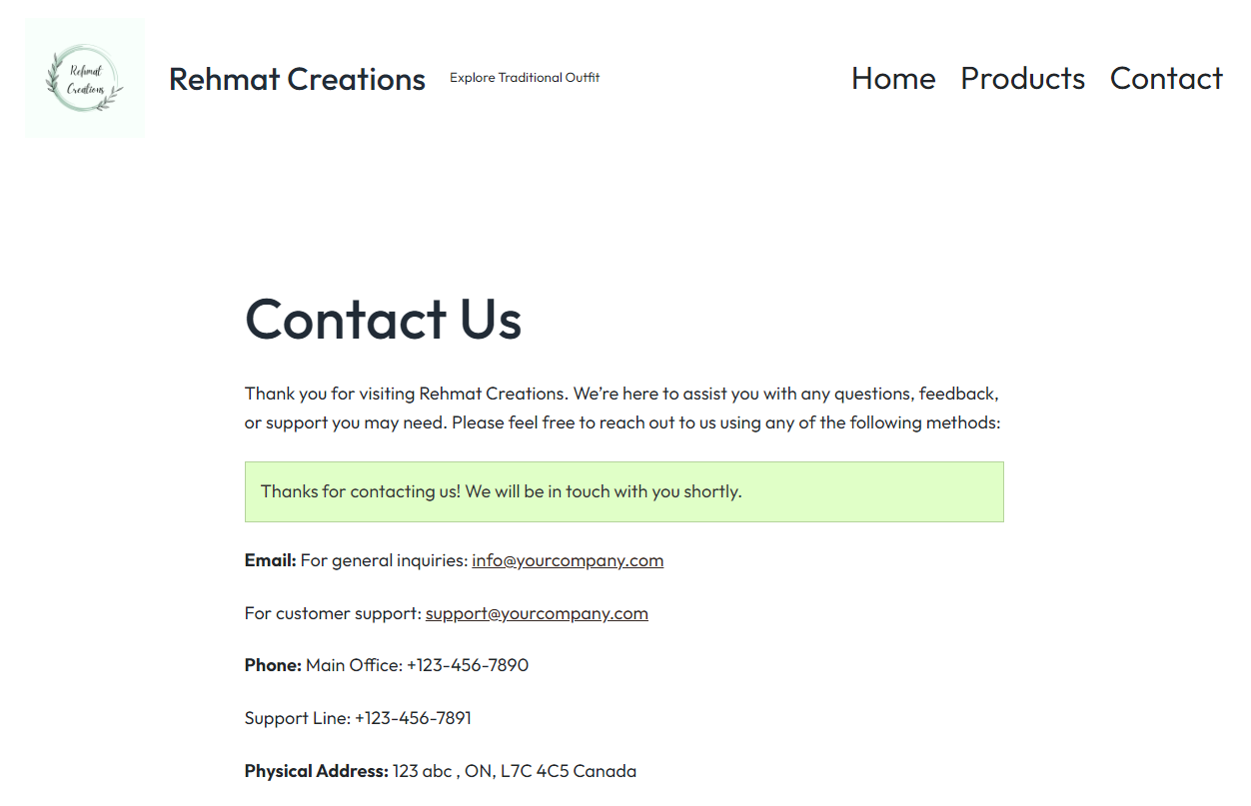
Message sent – Pluggins

Slide 13
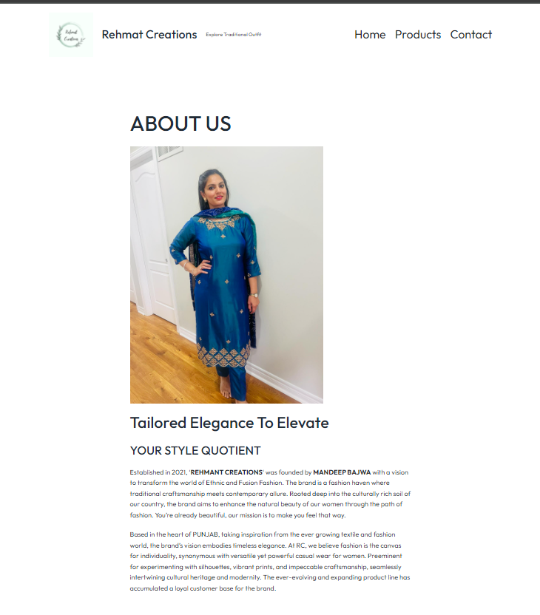
About Us Page

Slide 14
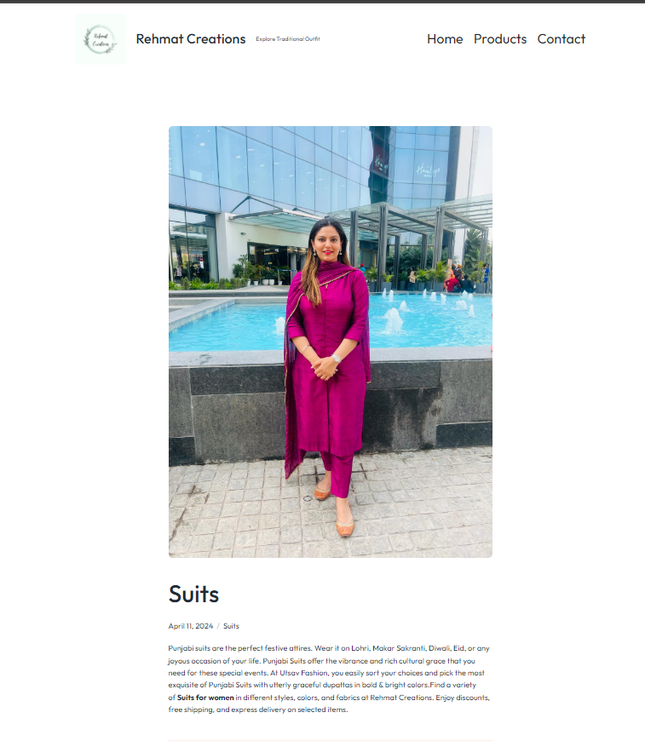
Blog Posts

Slide 15
END

